Slide 1
Second Iteration!
By Grant Gustafson

Slide 2

Interviews
Three interviews conducted.
One with Joe.
Two with CMCs working thought the Catechumenate.

Slide 3
Changes
I found some changes backed by multiple users that would be worth implementing.
How did I find these changes?

Slide 4
USER DATA!

Slide 5
User Roles
The first thing that I found was a new user sub role.
Ministry Participant: someone who is using the catechumenate specific as prep for ministry.
This demographic really wanted a forums page.

Slide 6
Work Notes
Mike: He barely had time to work on it became he was doing it in school.
Mike: He wishes he could spend more time focusing on the deep spiritual questions.
Mike: He wants to see what others are thinking, and how they are interaction with the N.C.
Karren: She needs more time to read and reflect then what is offered in a condensed class.
Karren: Wants access to how others feel about it, use it, and apply it to ministry.

Slide 7
Update Diagrams and models
Need to update diagrams and models, add audio books.
Main models and diagrams
Flow diagram
Artifact model
Interactive model
Ecological designs model

Slide 8
Work Notes…Again
Karren: She would use the audio version instead of reading it.
Mike: He would use an audio book if he was in a rush.

Slide 9
Prototype Changes
Vertical design approach
Specific elements
  Timeline
  Planner
  Forum

Slide 10
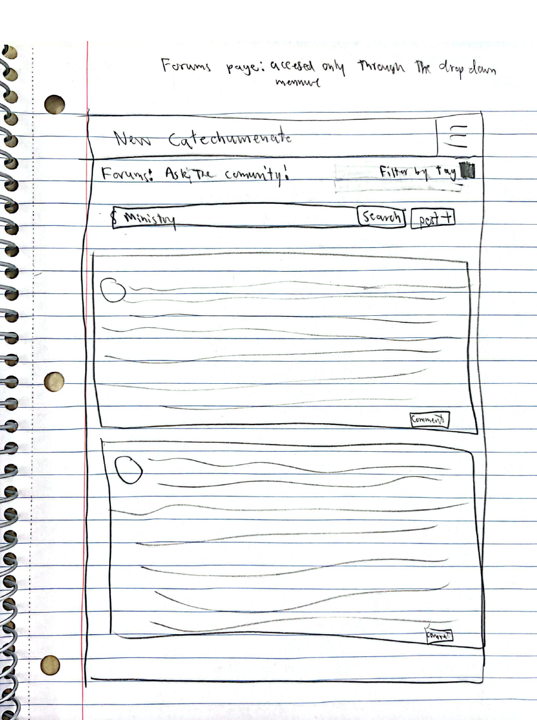
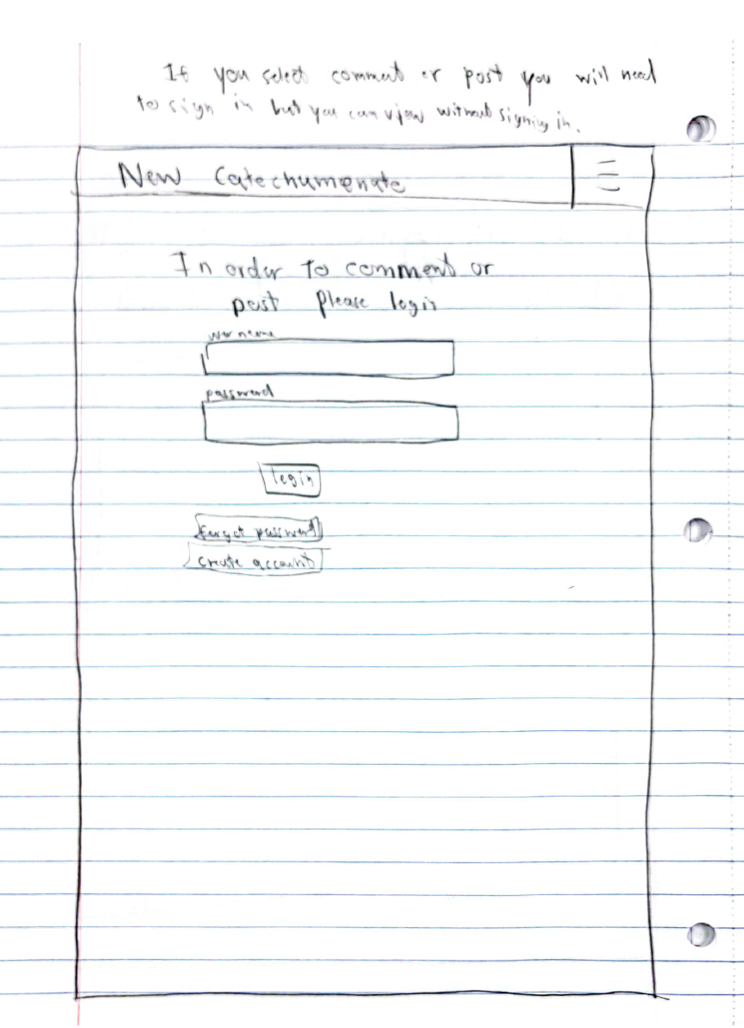
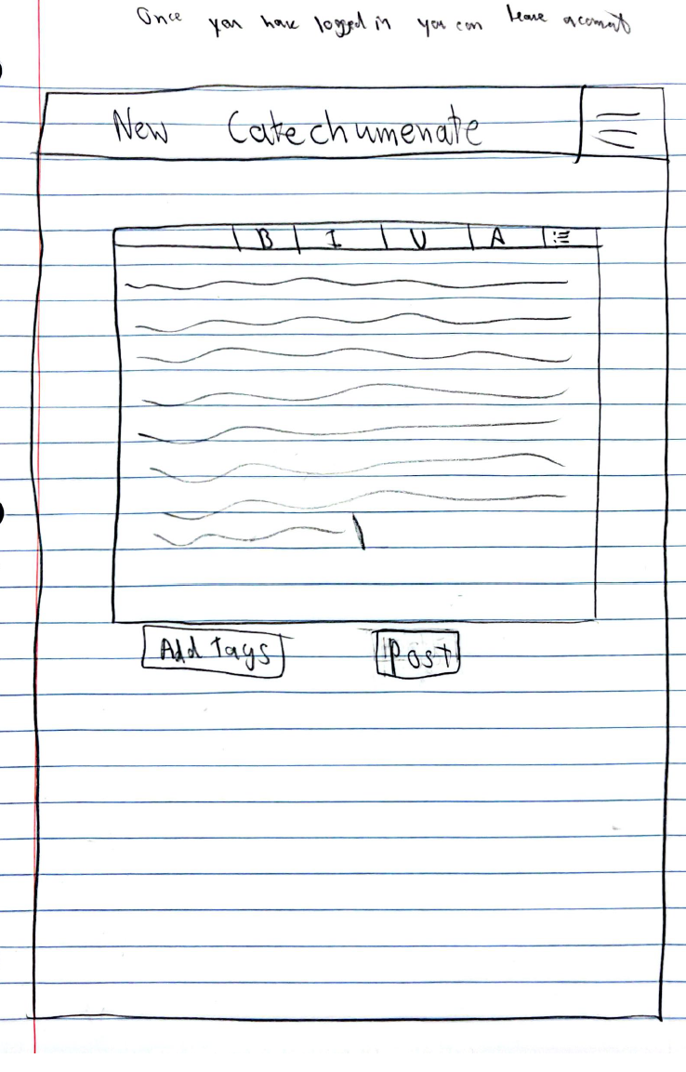
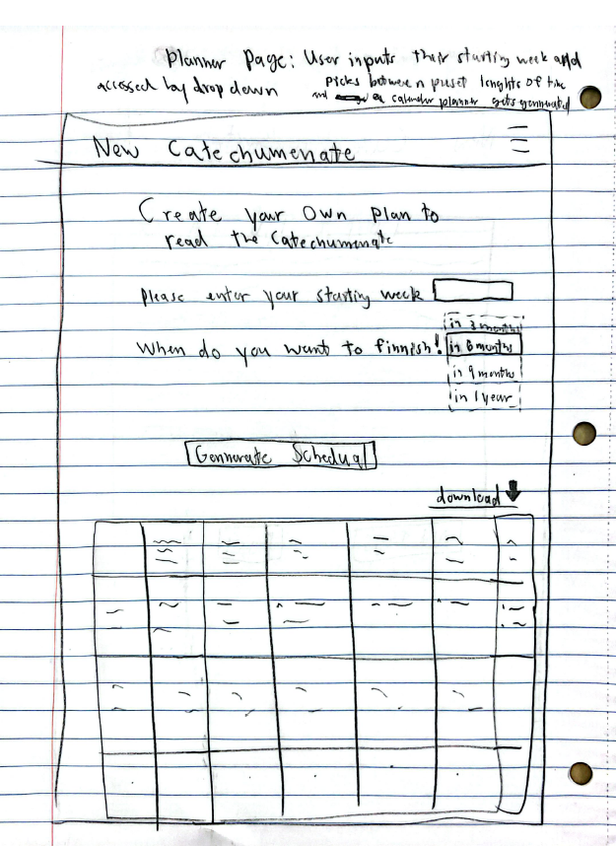
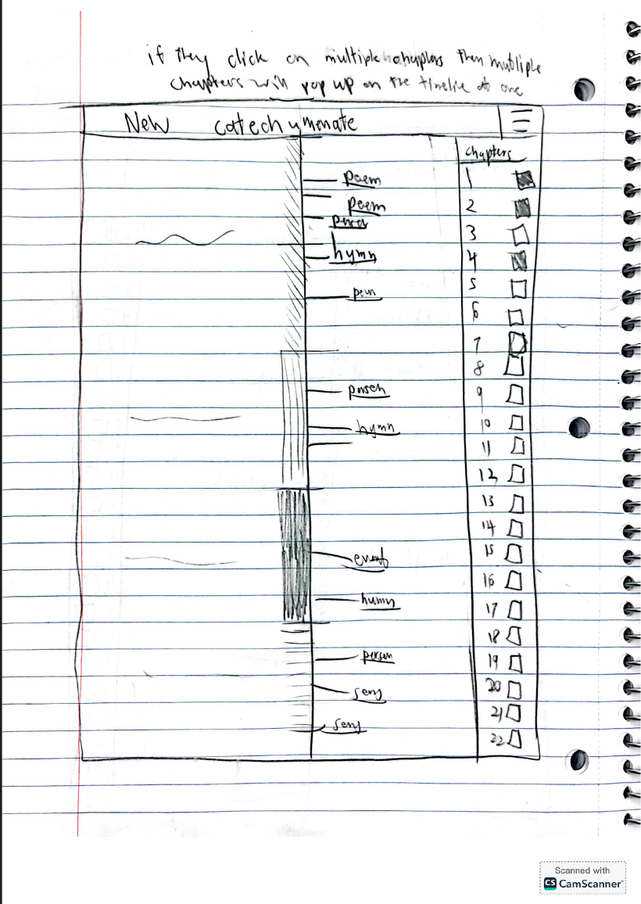
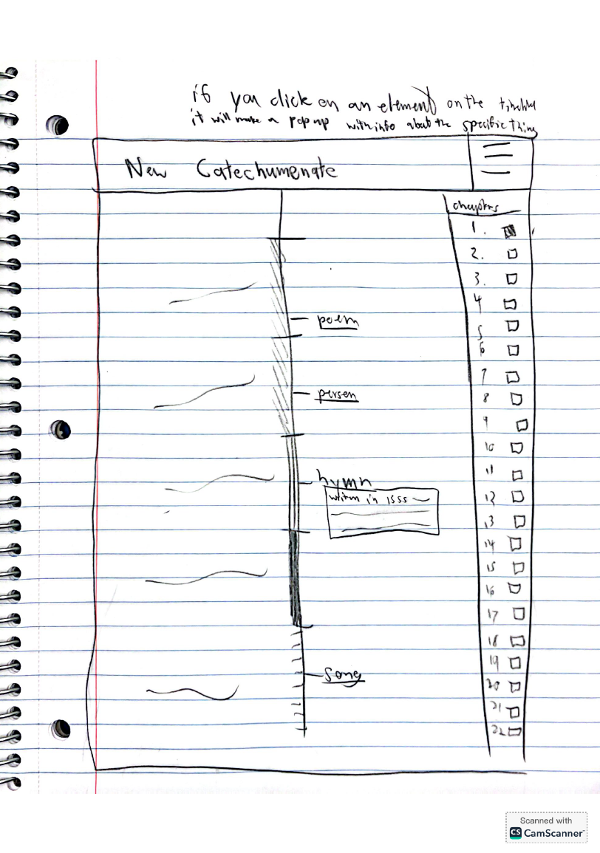
Implementation!!!!!
Planner
Forum
Timeline

